Slide 1
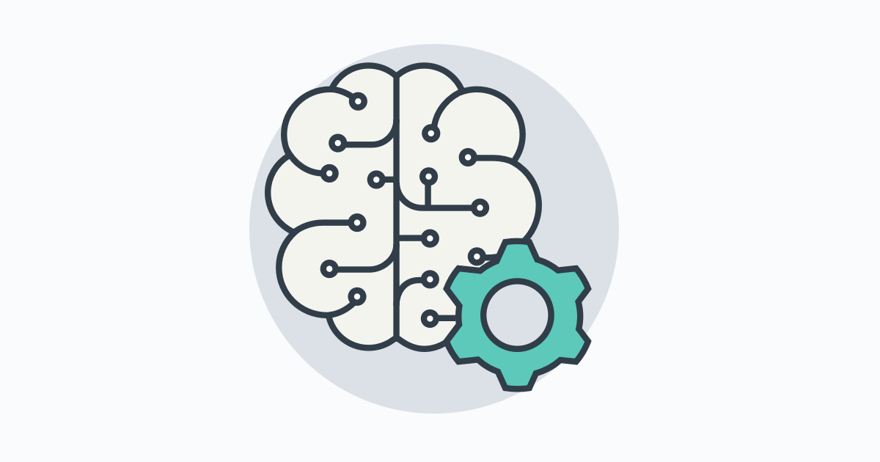
Introduction to Artificial Intelligence

Slide 2
AI is more feasible when:

Slide 3
AI is more feasible when:
The task doesn’t require much thinking/reasoning
Lots of (supervised) data is available

Slide 4
Anything you can do without much thought,
AI can do.
Input | Output | Application
Audio | Text transcript | Speech Recognition
Music | Like/not like | Music Recommendation
Photo | Image identification | Computer Vision
English | Chinese | Translation
Text | Meaning | Sentiment Analysis

Slide 5
What AI can do

Slide 6
Natural Language Processing

Slide 7
Text Classification

Slide 8
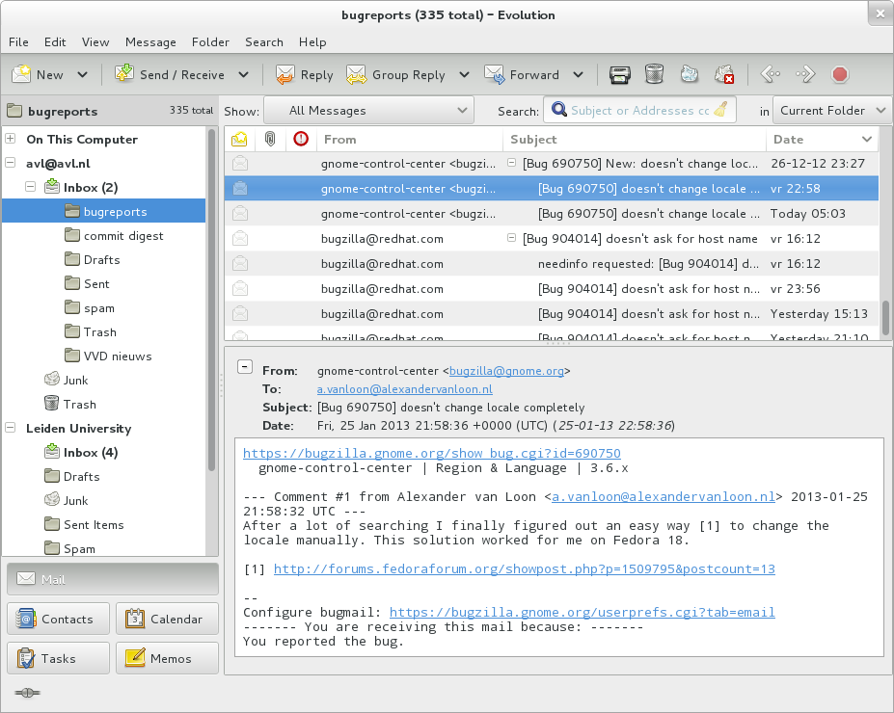
Text Classification
Spam/Not Spam

Slide 9
Sentiment Recognition

Slide 10
Sentiment Recognition
We enjoyed the food and the service was great.

Slide 11
Sentiment Recognition
We enjoyed the food and the service was great.

Slide 12
Sentiment Recognition
We enjoyed the food and the service was great.
We had to wait for an excessive amount of time and our order was wrong.

Slide 13
Sentiment Recognition
We enjoyed the food and the service was great.
We had to wait for an excessive amount of time and our order was wrong.

Slide 14
Informational Retrieval

Slide 15

Informational Retrieval

Slide 16
Machine Translation

Slide 17
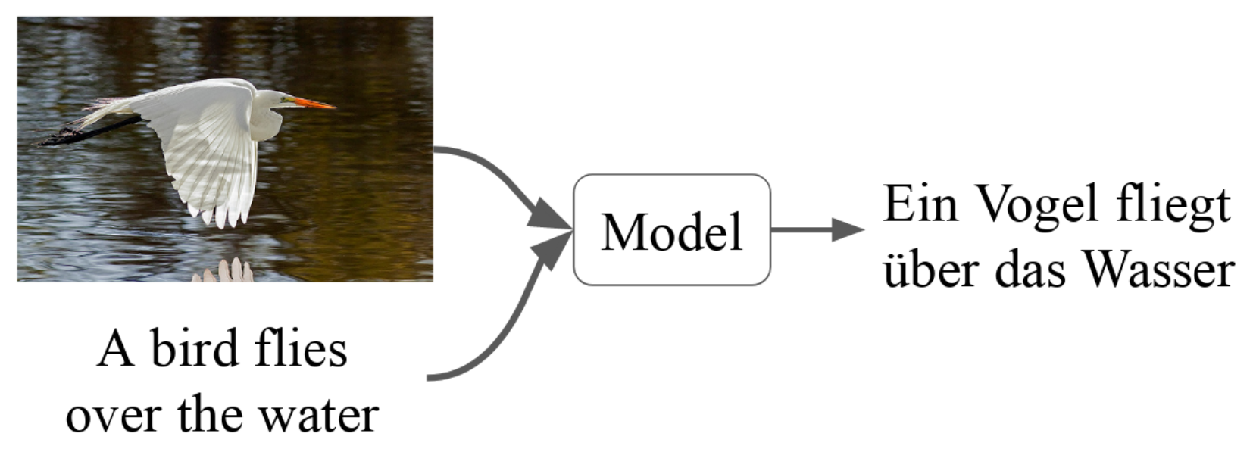
Machine Translation

Slide 18
Speech

Slide 19
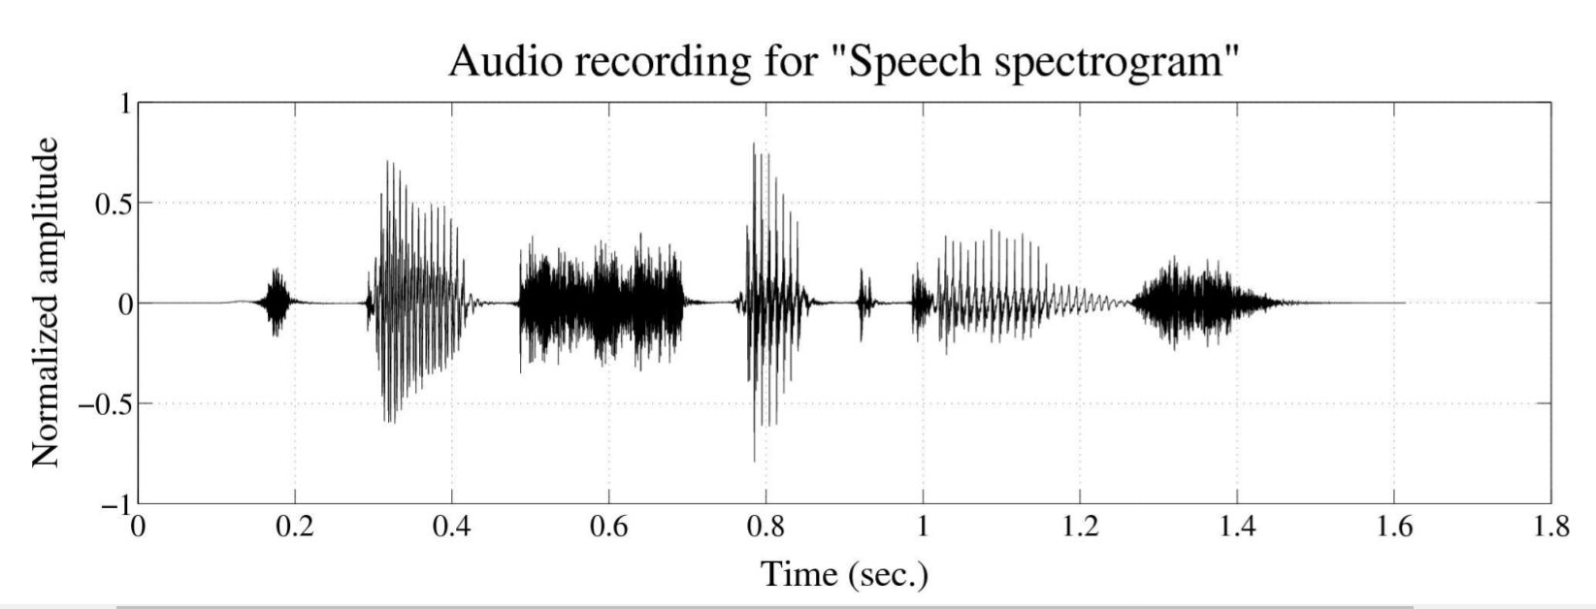
Speech Recognition
(speech-to-text)

Slide 20
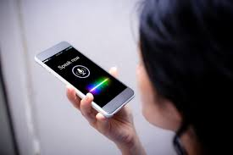
Speaker ID

Slide 21

Speech Synthesis
(text-to-speech)
Data is the new oil.

Slide 22
Computer Vision

Slide 23
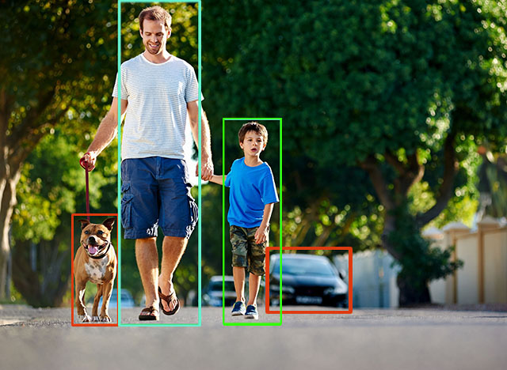
Understanding what’s in an Image

Slide 24
Face Recognition

Slide 25
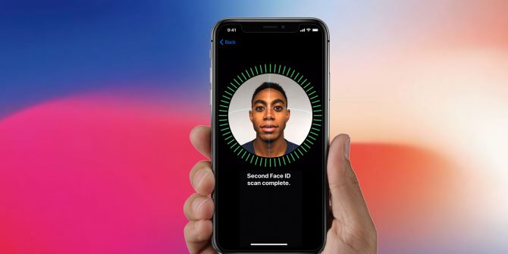

Slide 26
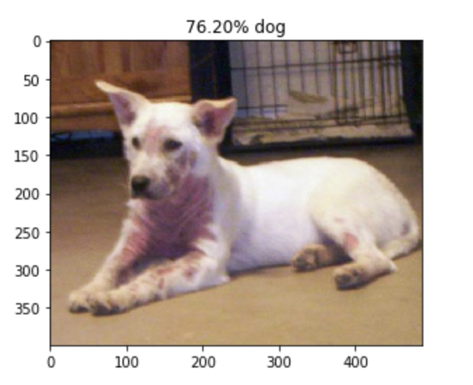
Image Classification

Slide 27
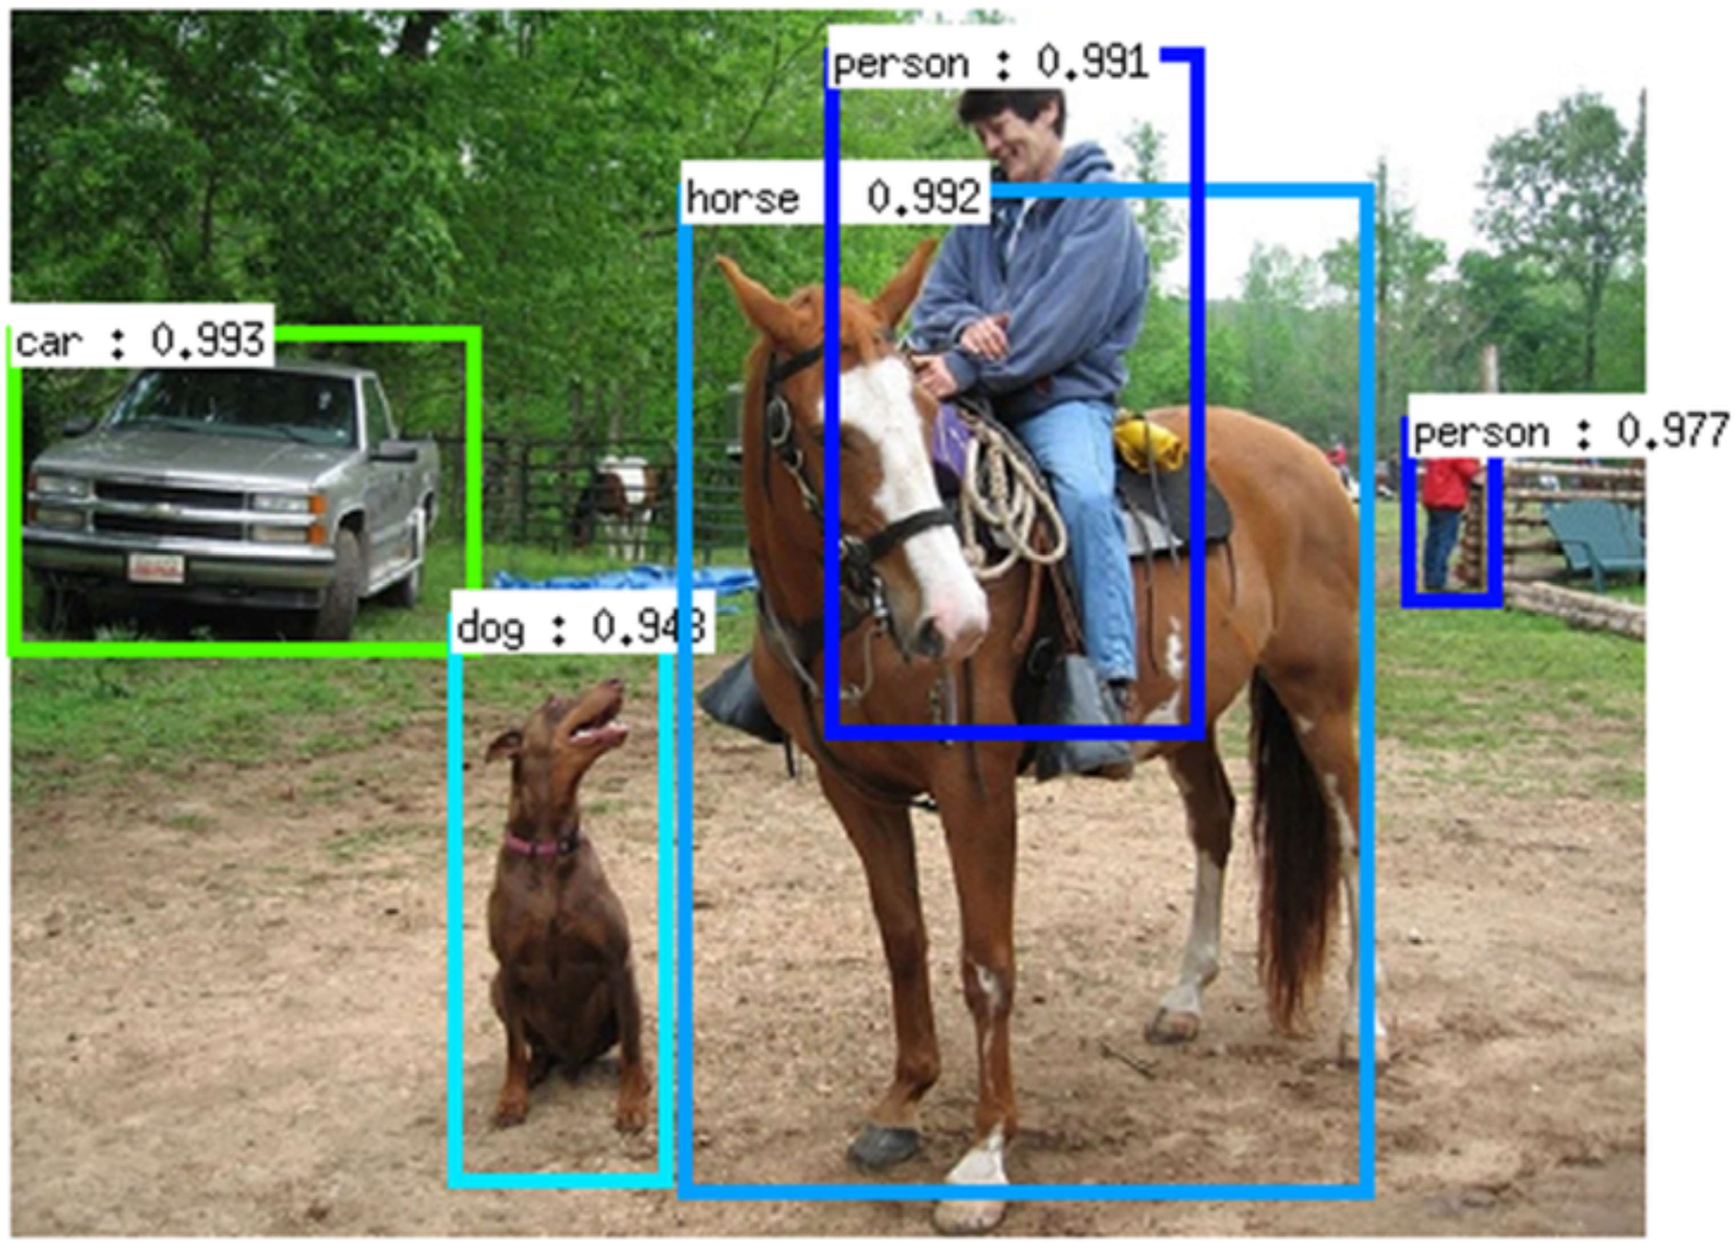
Object Detection

Slide 28
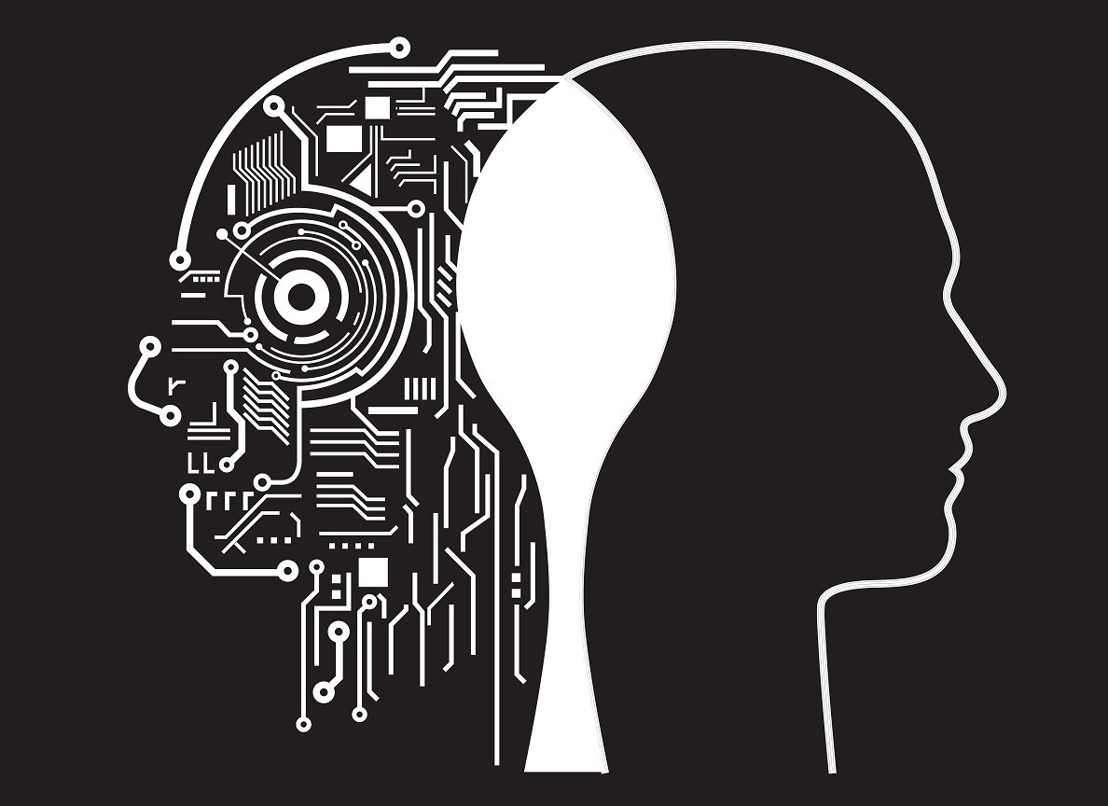
Machine vs. Man

Slide 29
Main advantages of Artificial Intelligence over Natural Intelligence are:
Incredible speed
Continuous operation
Less biased
Accuracy

Slide 30
Main advantages of Natural Intelligence over Artificial Intelligence are:
Generalizing knowledge
Multi-tasking
Differentiating subtleties of context
Complex movements

